Slide 1
SAP EWM EXTENDED WAREHOUSE MANAGEMENT TRAINING
AnubhavTrainings.com
www.anubhavtrainings.com

Slide 2

SAP EWM TRAINING
BY:-
Mr. Bijoy
www.anubhavtrainings.com
Notes:
https://unsplash.com/photos/uXB-7la5vqA

Slide 3
SAP EWM TRAINING (Day 12)
AnubhavTrainings.com

Slide 4
Physical Inventory
Define Physical Inventory area, Number range for Physical Inventory docs, Physical inventory specific settings
Storage bin specific PI, Product specific PI
Cycle Counting Physical inventory

Slide 5
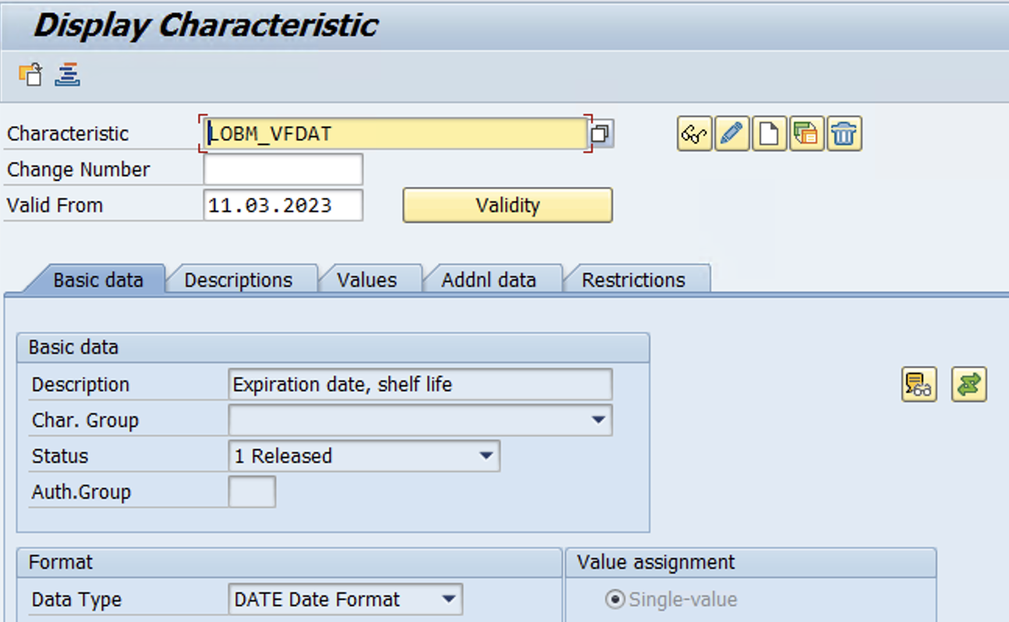
Batch Management
Configuration
Create Characteristics (Tcode – CT04)
Use Standard Characteristics for Remaining shelf life for Batch
LOBM_VFDAT, LOBM_RLZ & LOBM_LFDAT
www.anubhavtrainings.com

Slide 6
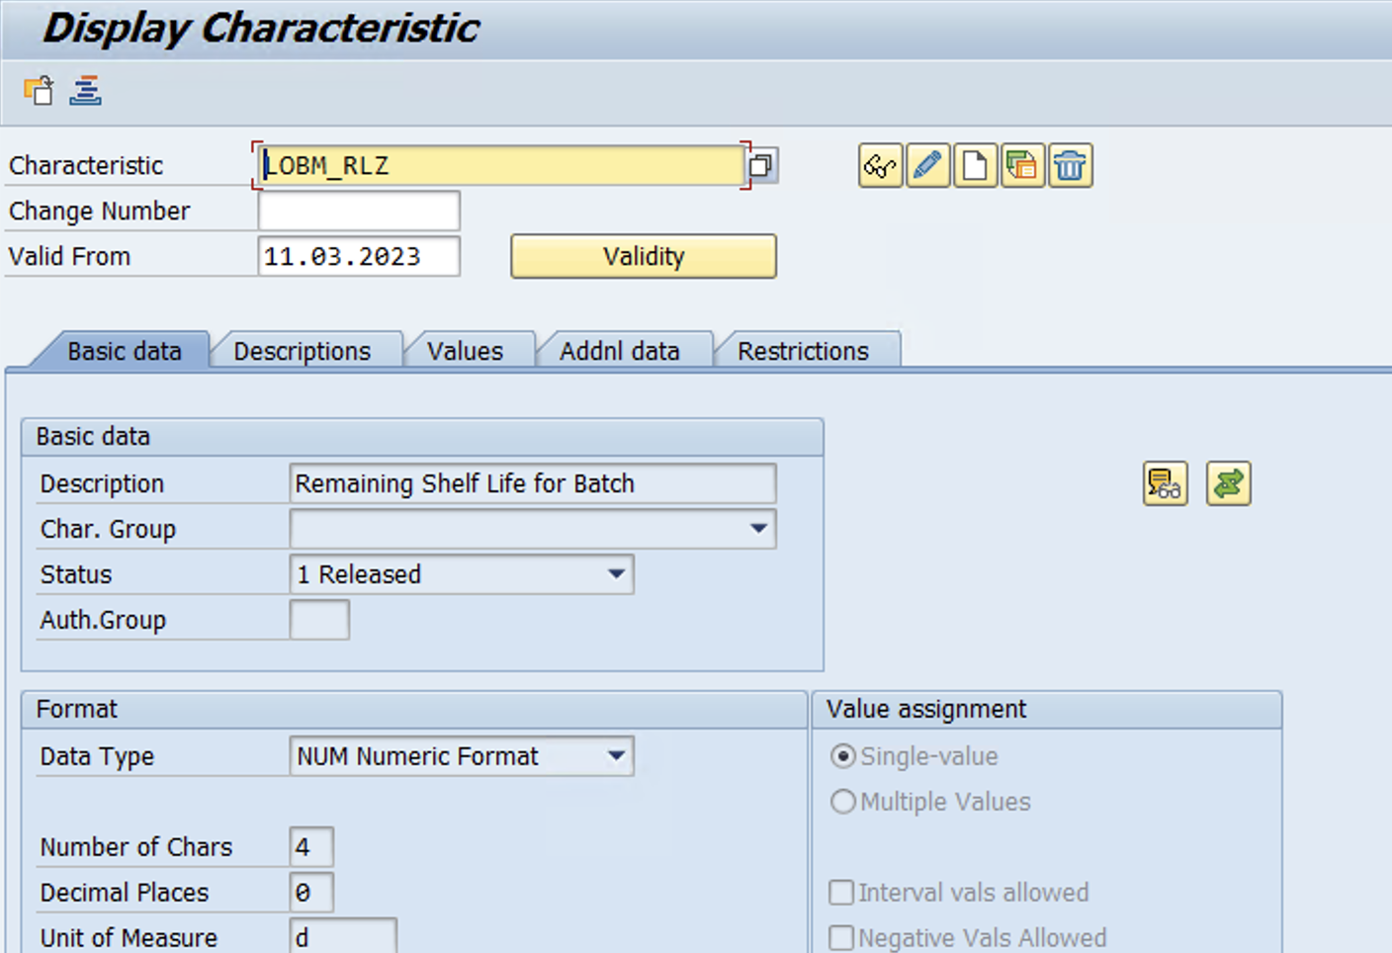
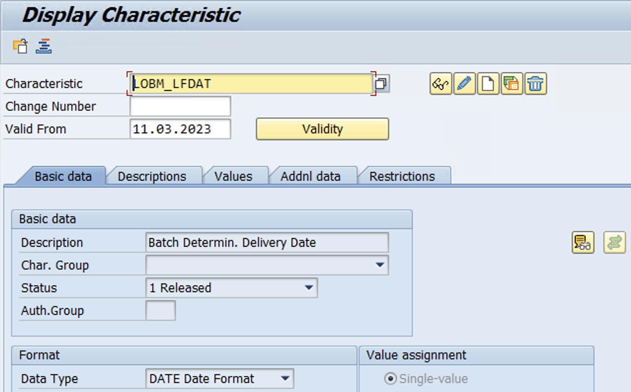
www.anubhavtrainings.com

Slide 7
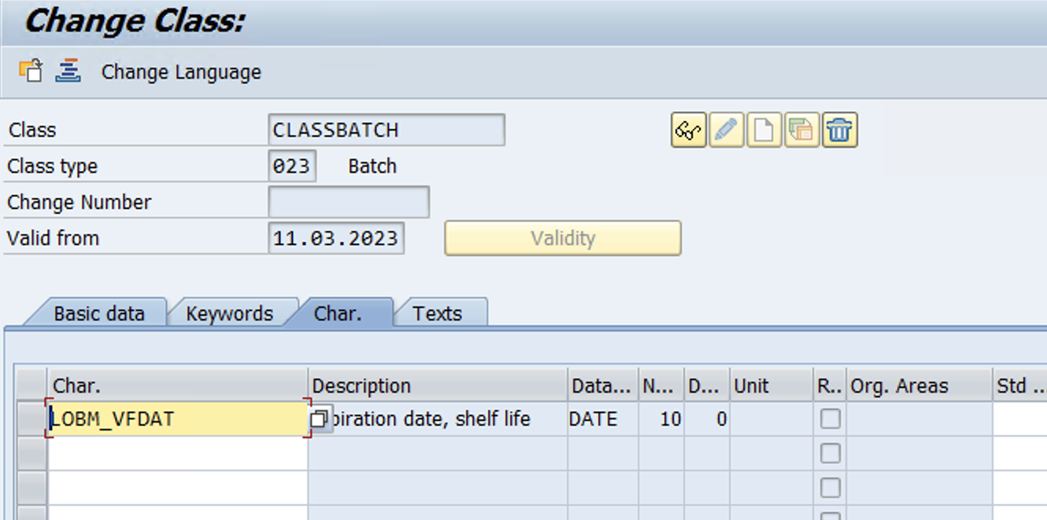
Create Class (Tcode – CL01)
www.anubhavtrainings.com

Slide 8
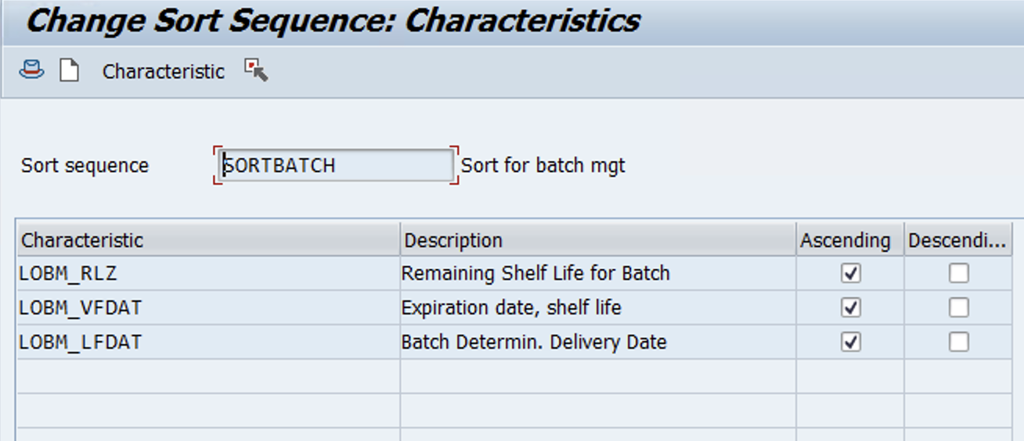
Create Sort Sequence (Tcode – CU70)
www.anubhavtrainings.com

Slide 9
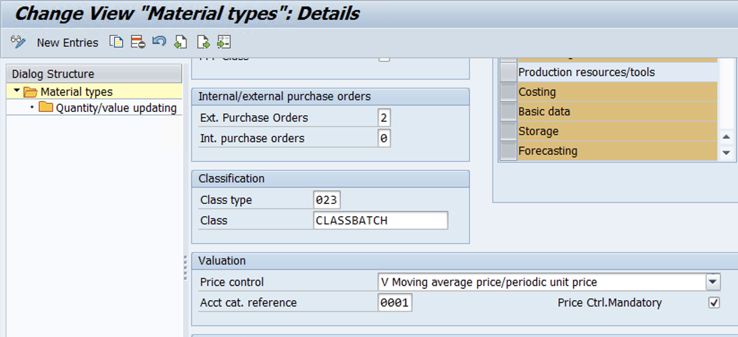
Update Class & Class type in tcode – OMS2
www.anubhavtrainings.com

Slide 10
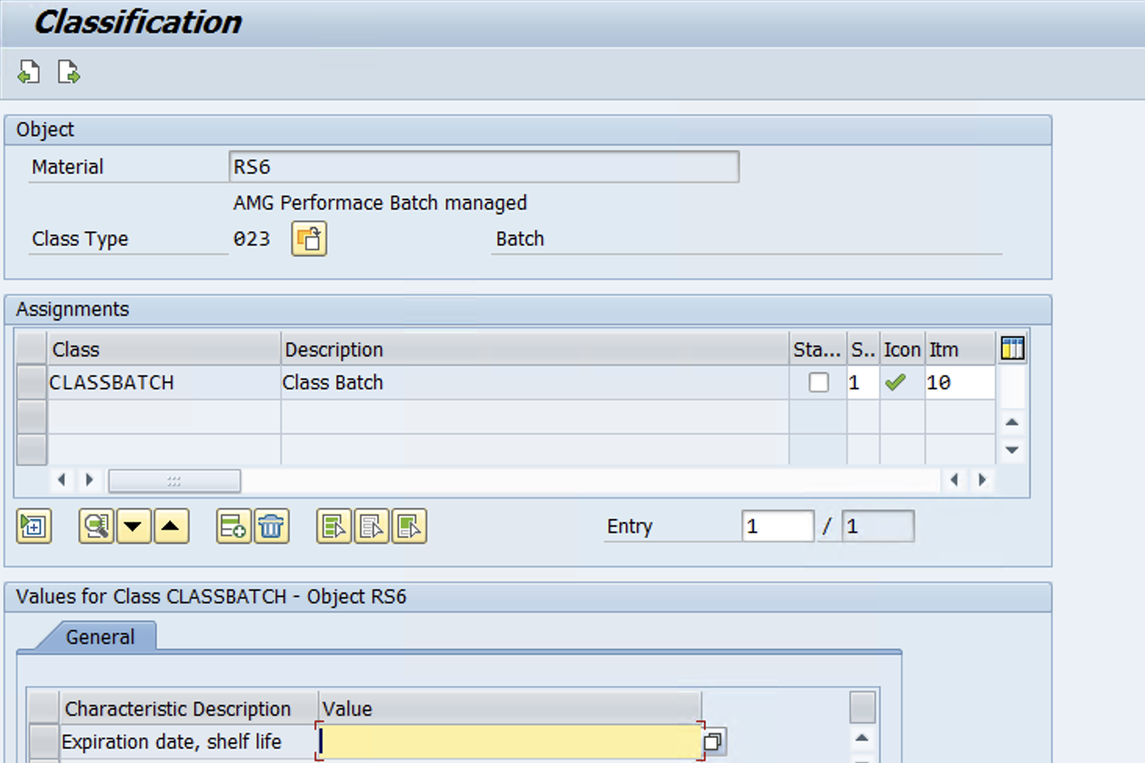
Maintain Material Master with Classification data & Activate Batch management at Purchasing level -

Slide 11
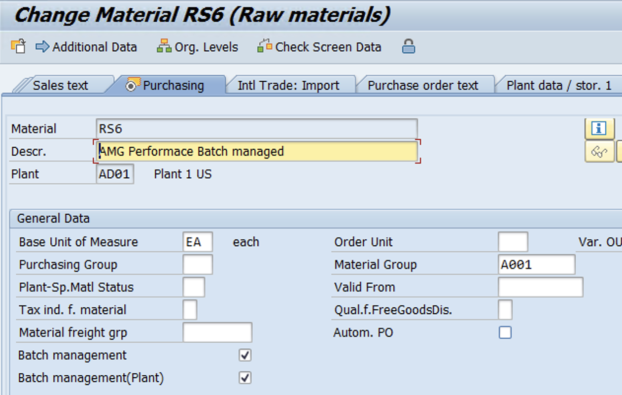
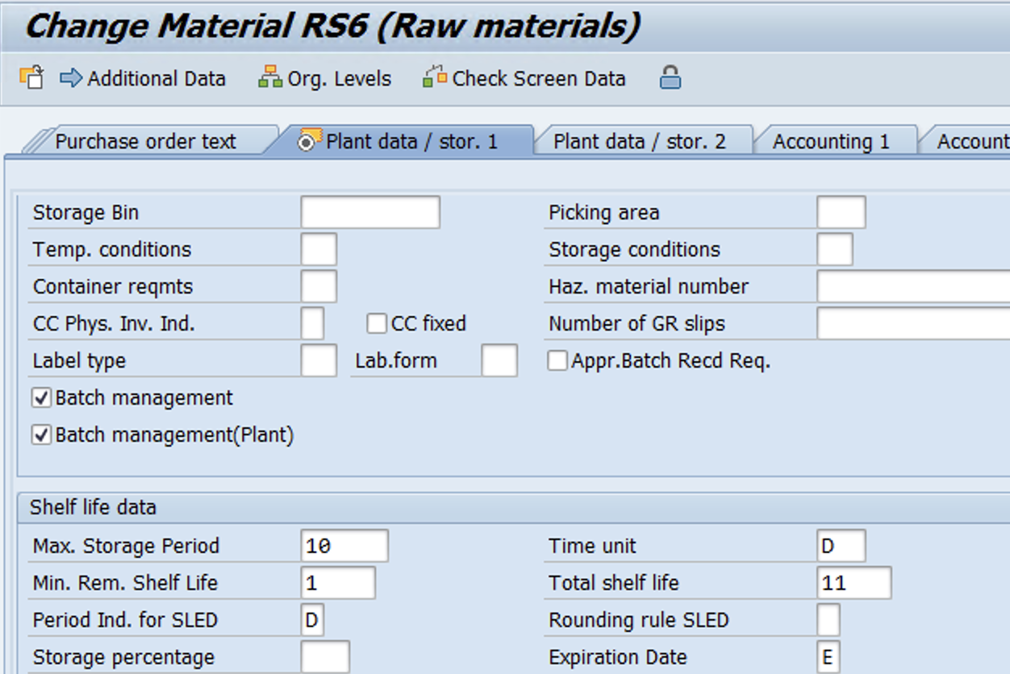

Slide 12
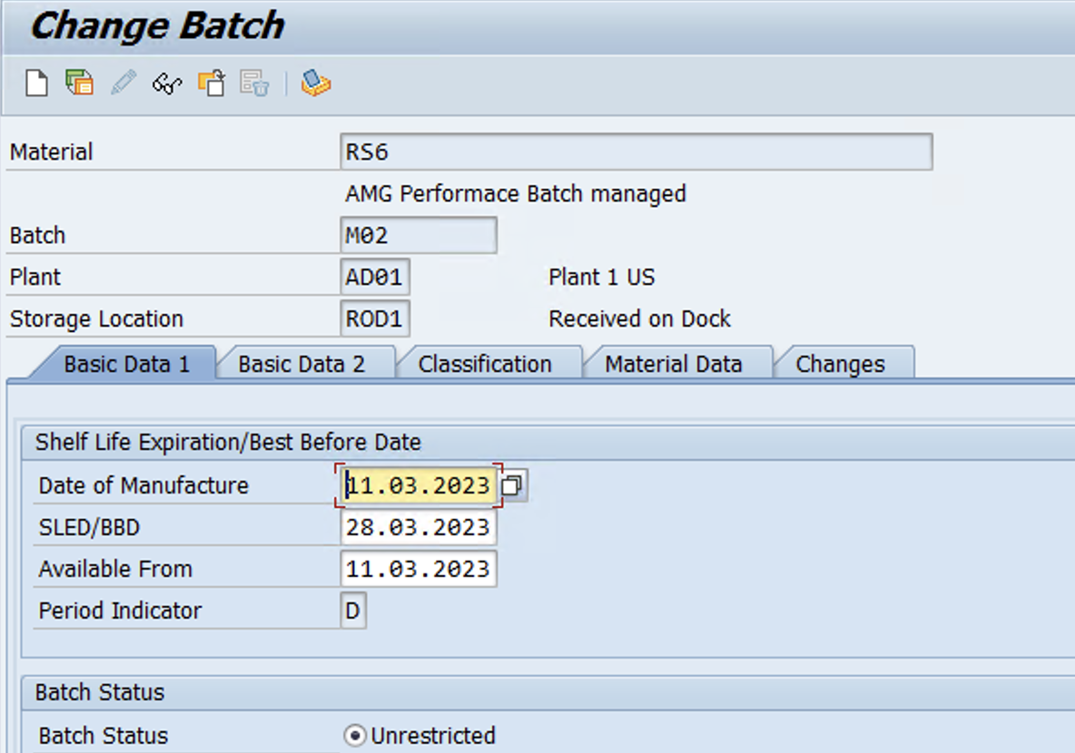
Create Batch using tcode – MSC1n
Please Note – SLED date has been changed manually for testing purposes!!

Slide 13
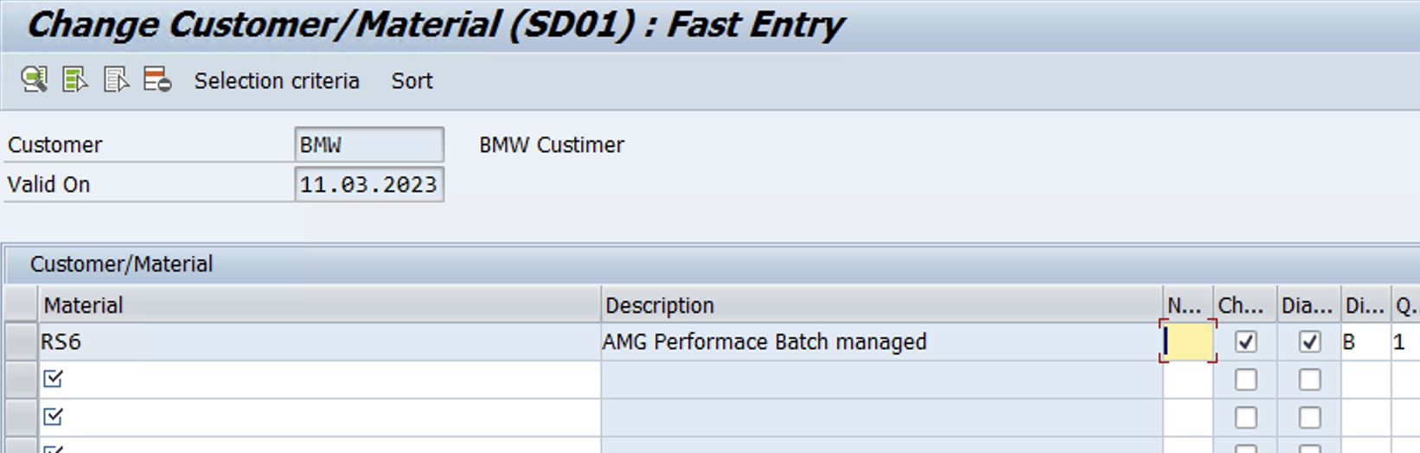
Maintain Customer/Material condition record in Tcode – VCH1
Selection Criteria
www.anubhavtrainings.com

Slide 14
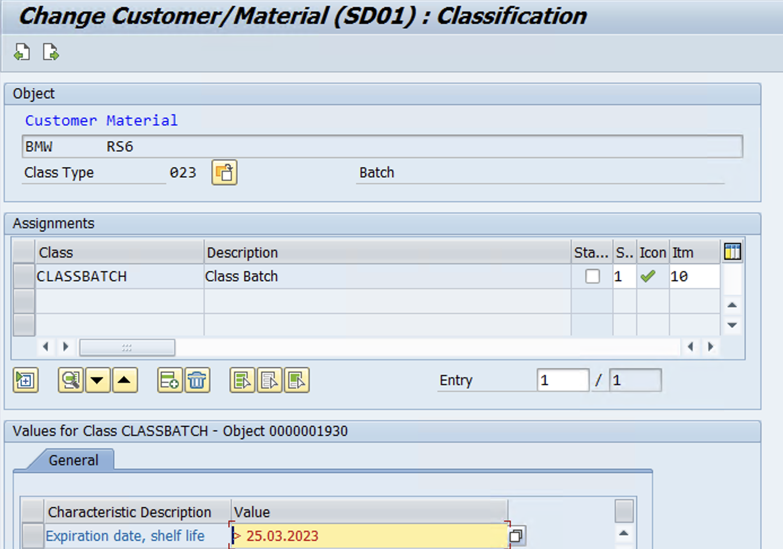
www.anubhavtrainings.com

Slide 15
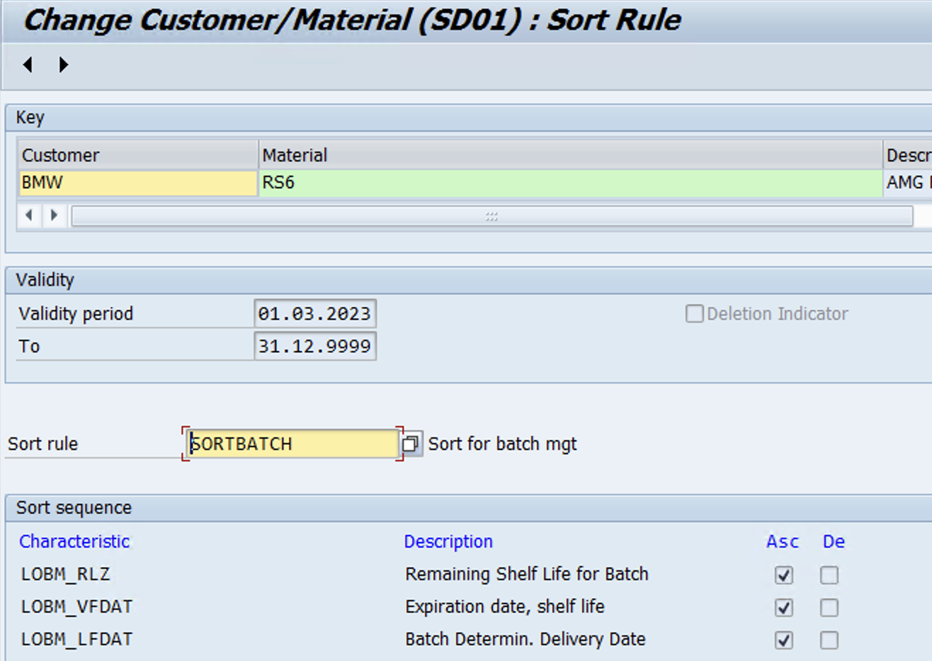
Sort
www.anubhavtrainings.com

Slide 16
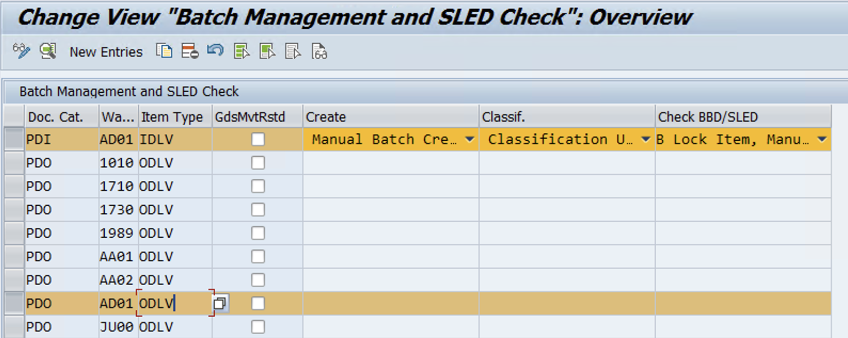
EWM Configuration
IMG > EWM > Cross-process setting > Batch Management > Define setting for delivery - Warehouse request
www.anubhavtrainings.com

Slide 17
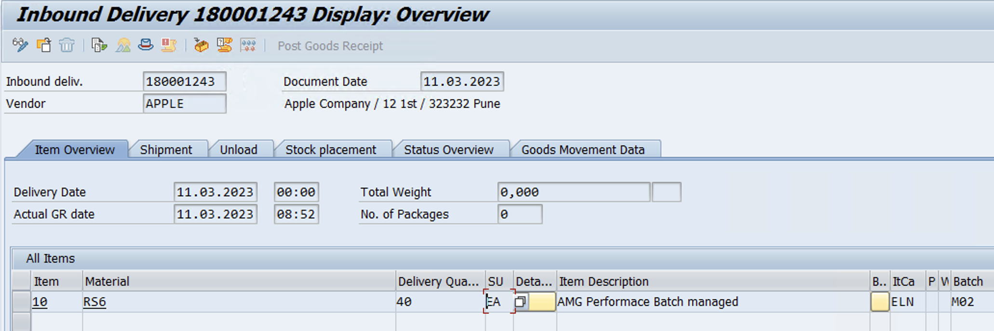
Test Case (Inbound)
Create PO > IBD (Enter Batch no while processing IBD)
www.anubhavtrainings.com

Slide 18
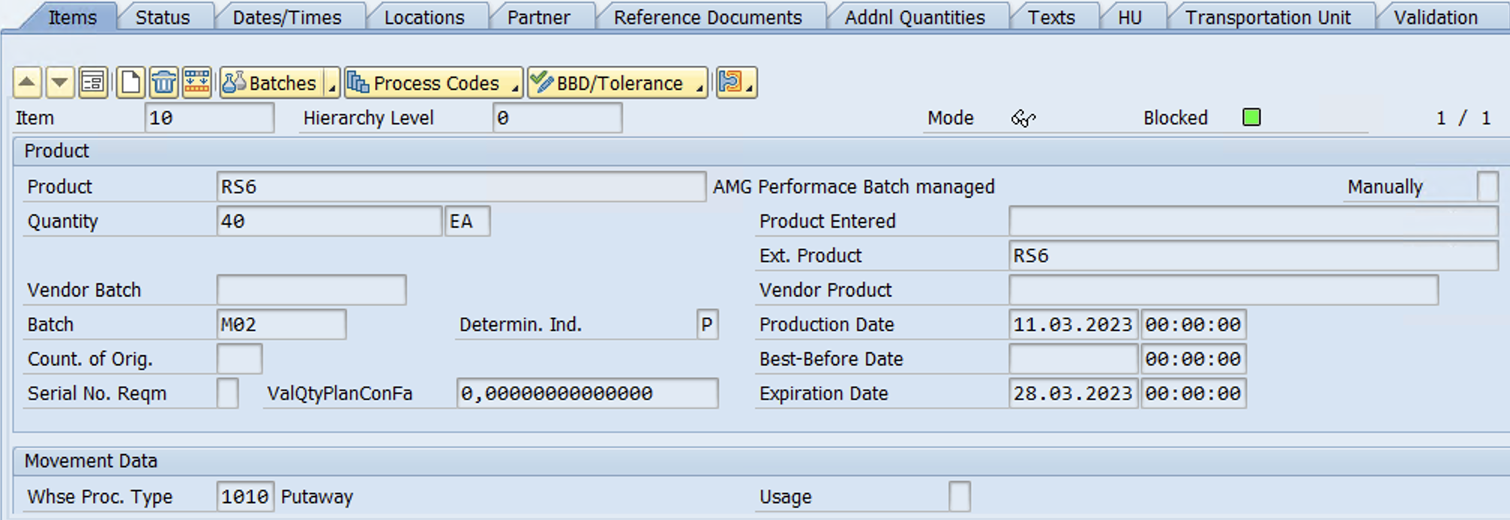
Check IBD in EWM – Batch & Expiration date
www.anubhavtrainings.com

Slide 19
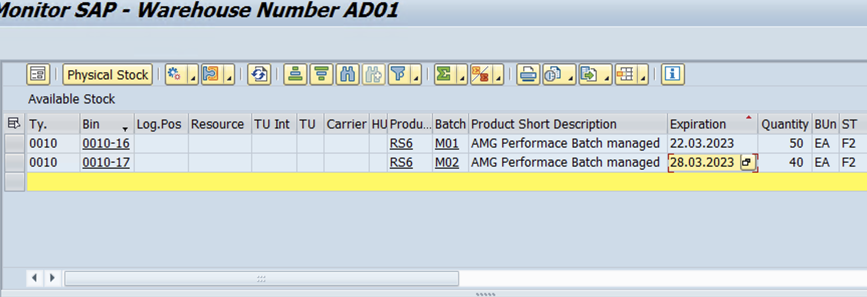
Stock available in batches – Warehouse Monitor
www.anubhavtrainings.com

Slide 20
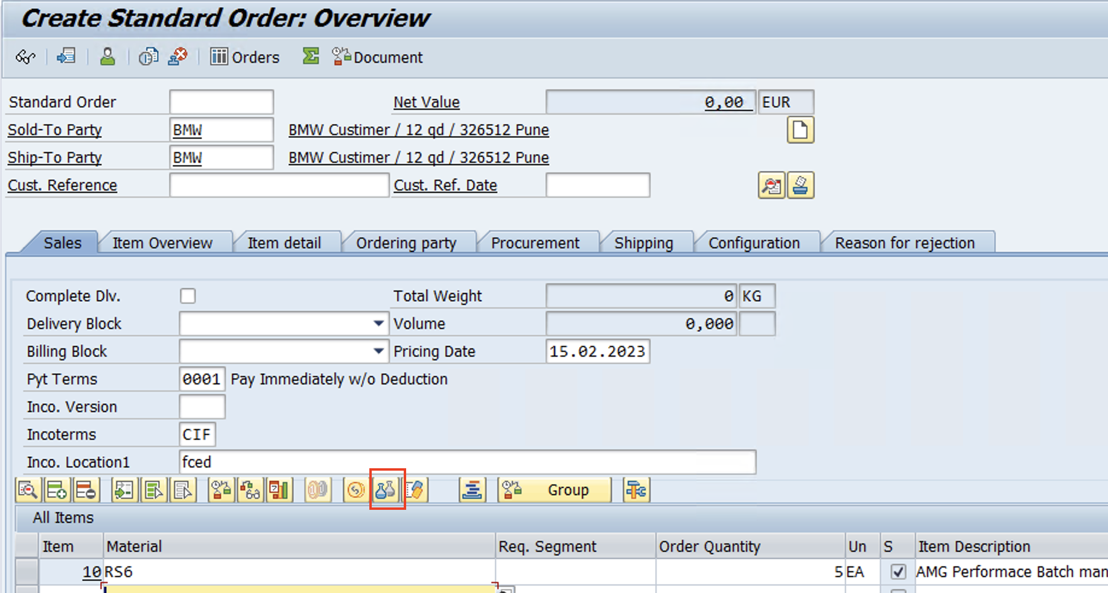
Test Case – Batch Selection Criteria (Outbound)
Scenario – While Picking WT system should check the batch selection criteria
Create Sales order – Click on Batch determination
www.anubhavtrainings.com

Slide 21
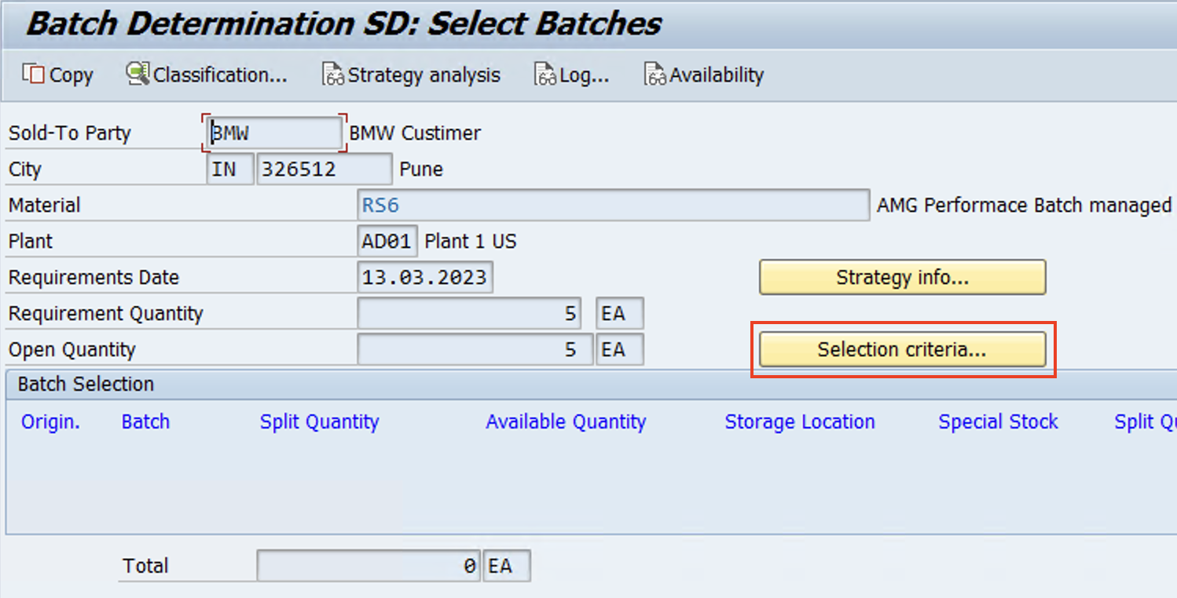
Click on Create

Slide 22
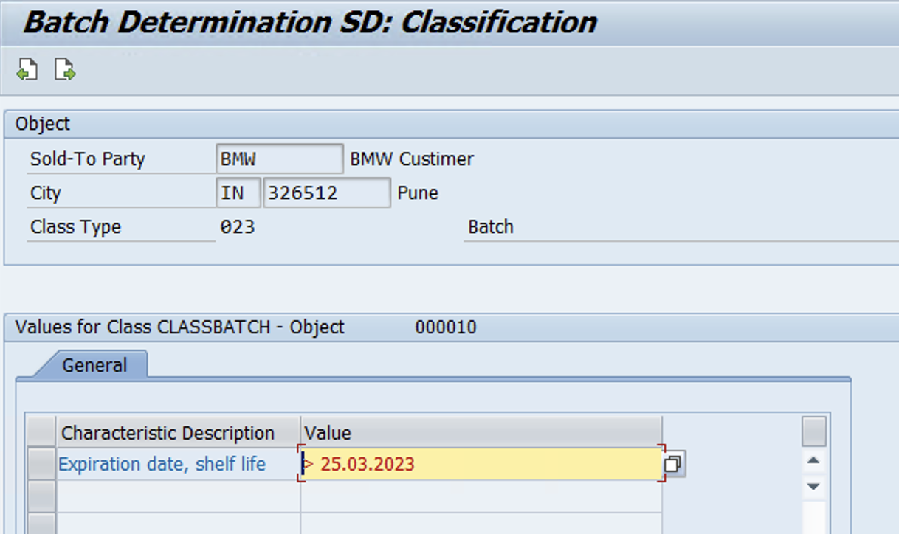
Enter date > Back > Press F5 > Create Sales Order

Slide 23
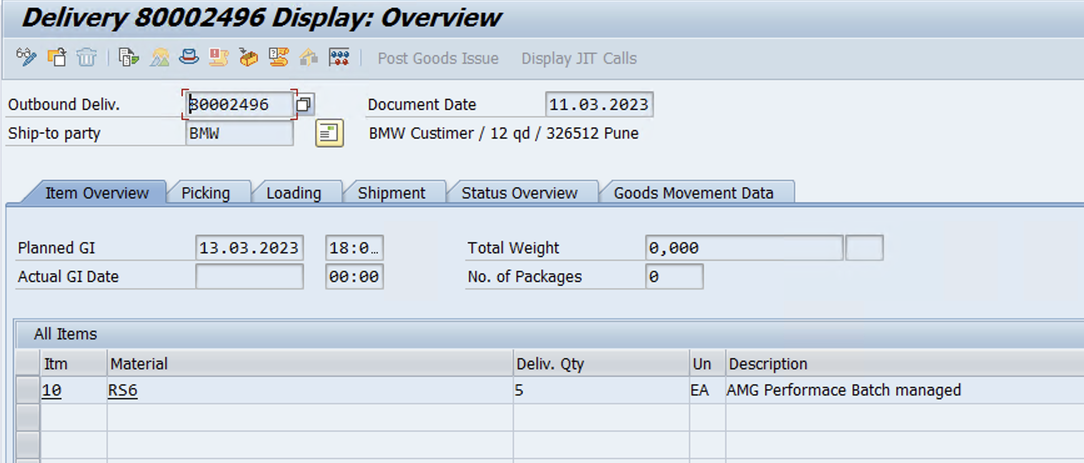
Create Outbound delivery
www.anubhavtrainings.com

Slide 24
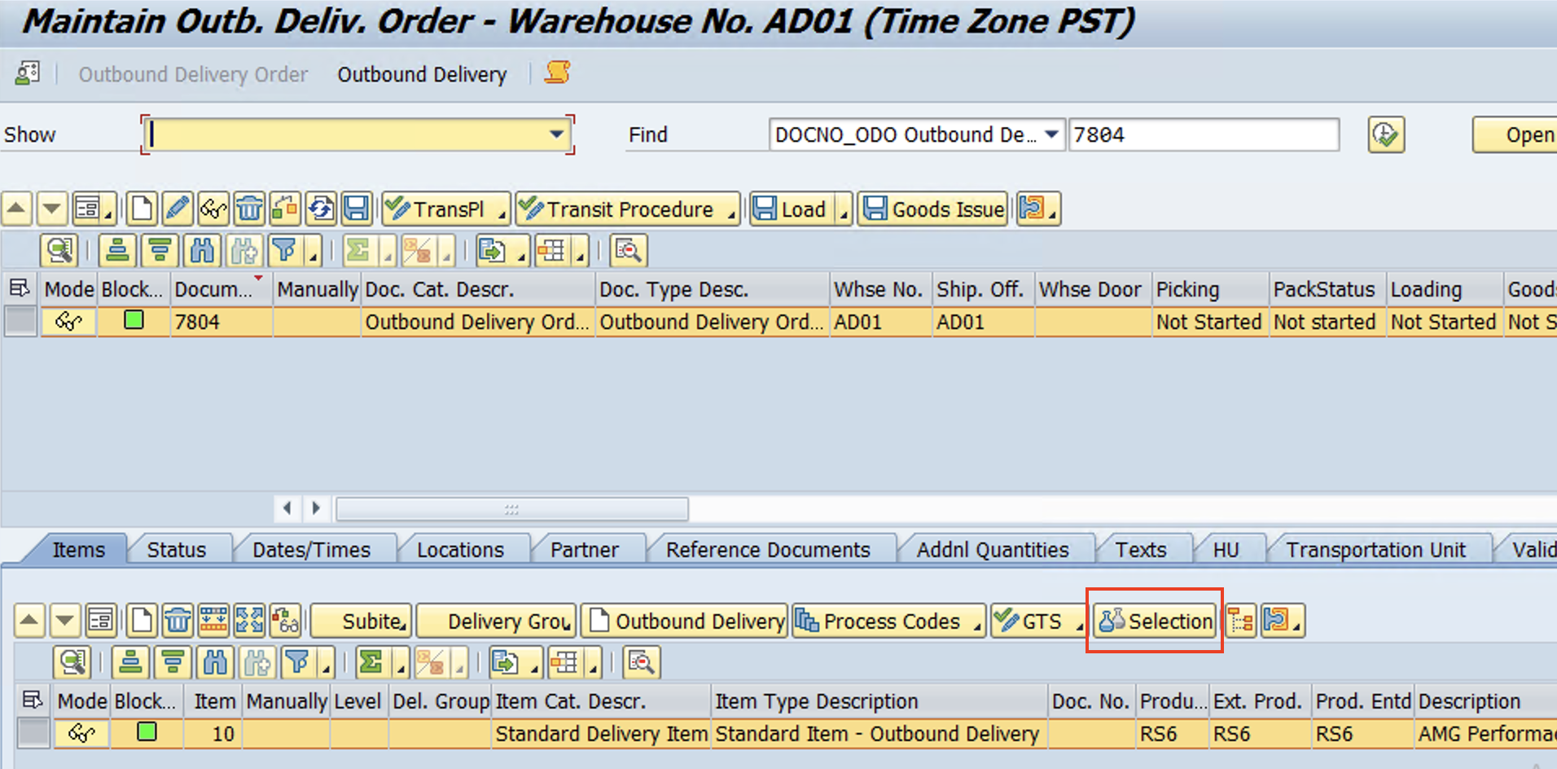
Delivery distributed to EWM
www.anubhavtrainings.com

Slide 25
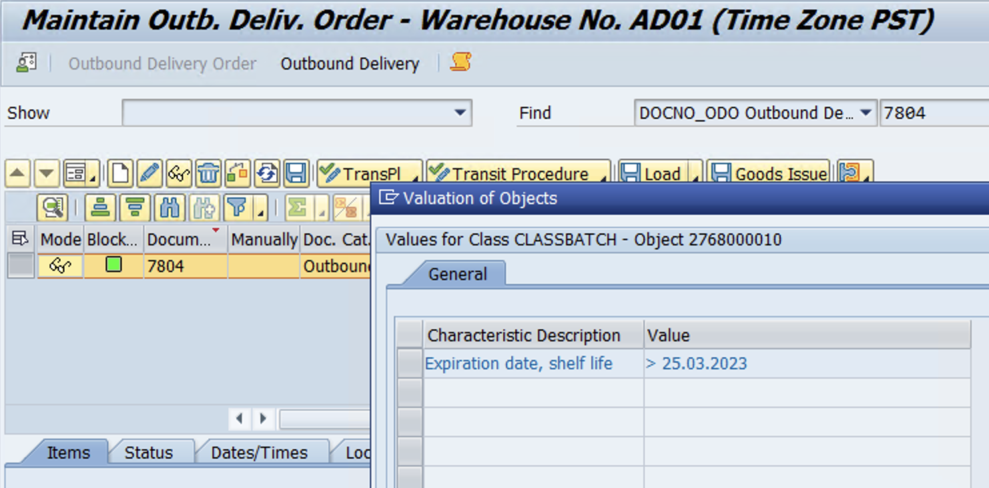
Batch selection criteria copied from Sales Order
www.anubhavtrainings.com

Slide 26
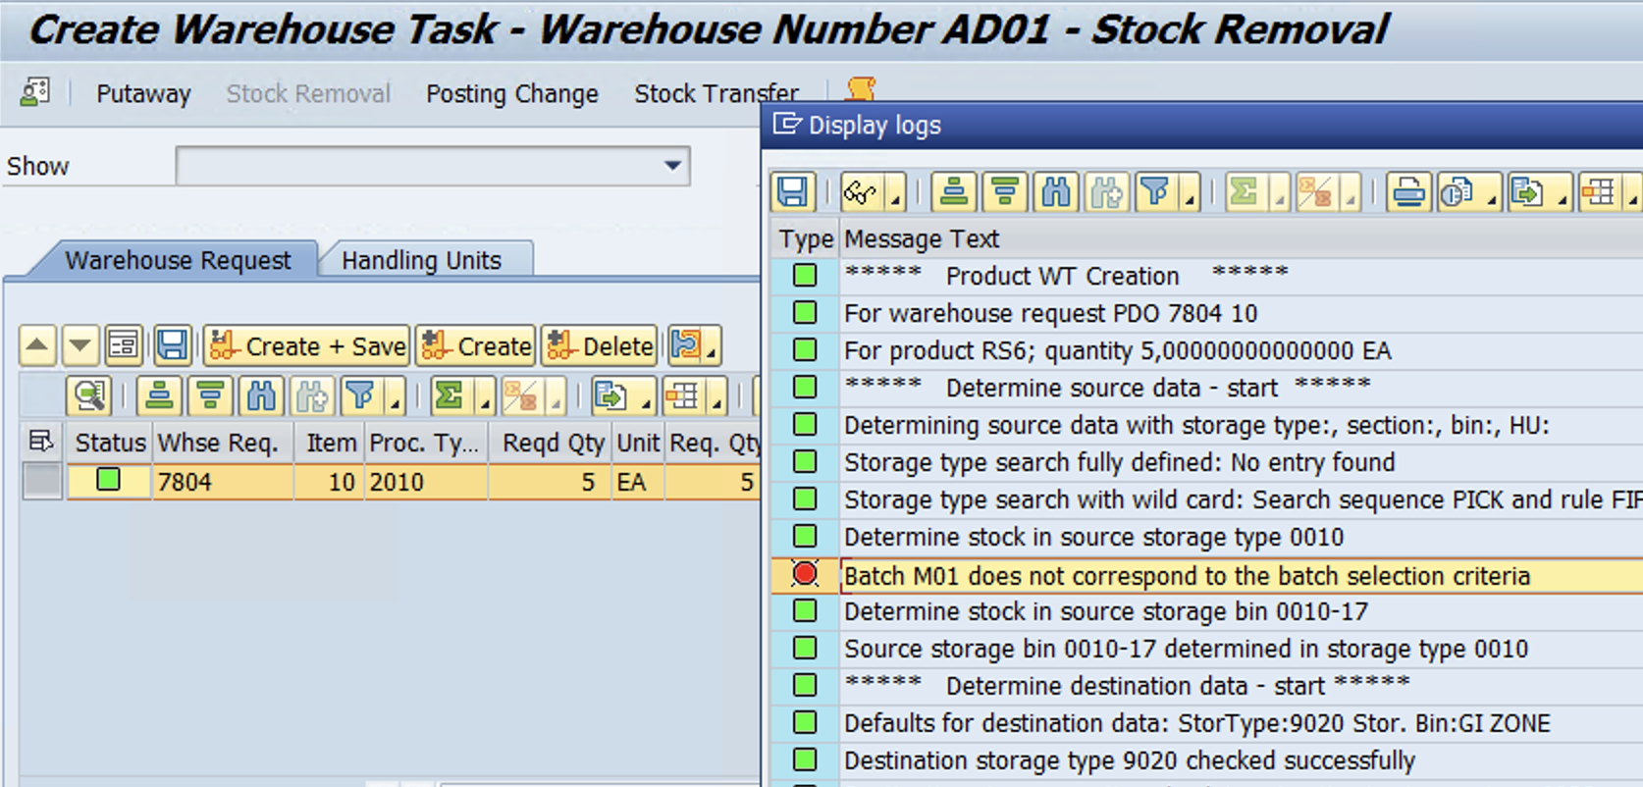

Slide 27
Stock in Warehouse Monitor
www.anubhavtrainings.com

Slide 28
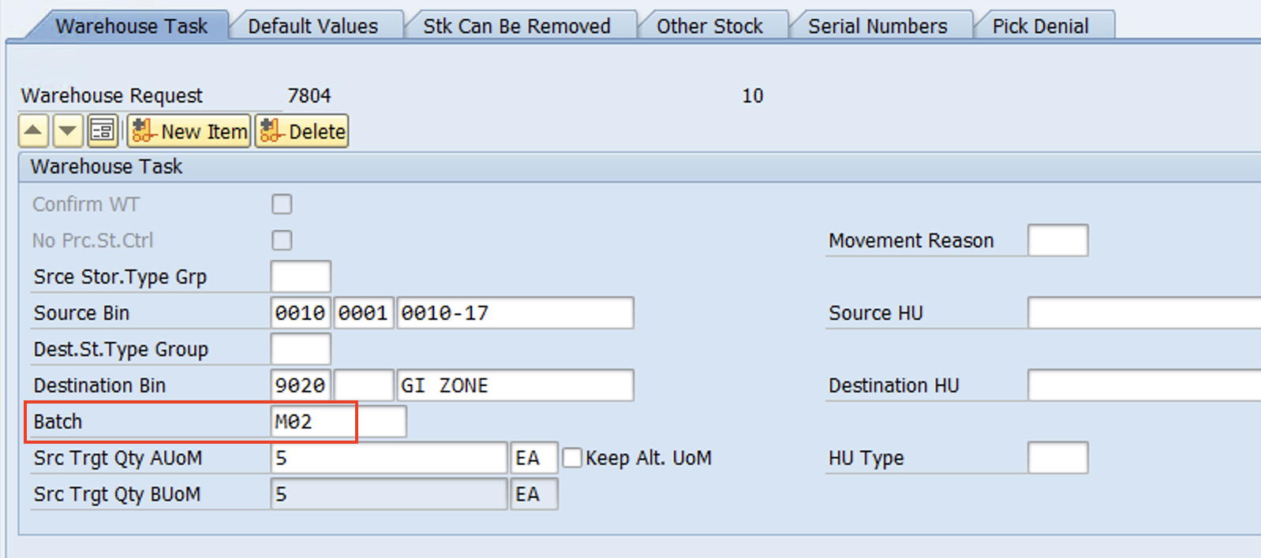
Batch M02 determined by System as per Batch selection criteria
WT Confirmed!
www.anubhavtrainings.com

Slide 29
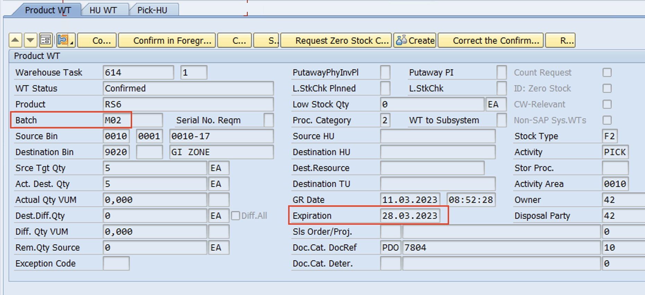
WT Confirmed!

Slide 30


End of Session 12
www.anubhavtrainings.com

Slide 31

FEEL FREE TO ASK QUESTIONS

Slide 32

Feedback

Slide 33
THANK
YOU

Slide 34




More from AnubhavTrainings.com

Slide 35






We’re committed to empower you to be
#FutureReady
through powerful training solutions.
We build the workforce of the future.
250+
Corporate Clients
30,000+
Learners Trained
25000+
Learners Placed
FREE WEBINARS
Sign up for free webinars with industry experts every fortnight!
Enroll Now!

Slide 36
FREE WEBINARS
Sign up for free webinars with industry experts every fortnight!
Contact us today!
www.anubhavtrainings.com

